Slide 1
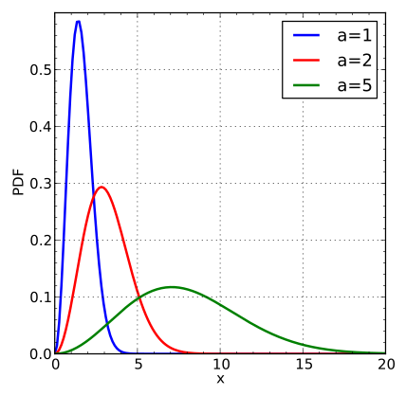
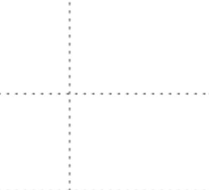
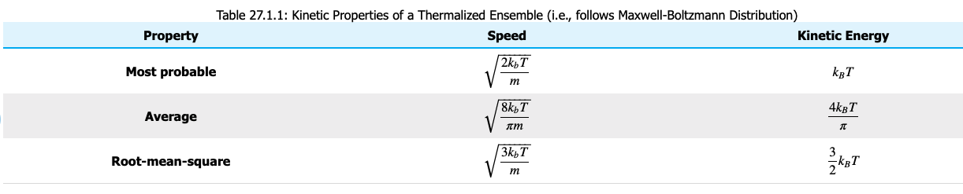


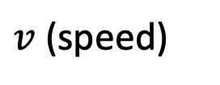



Recap of the averages
$$f_{M}$$
$$c^{∗}$$
$$\overline{c}$$
$$c$$
$v$ (speed)
$c^{∗}<\overline{c}<c$

Slide 2
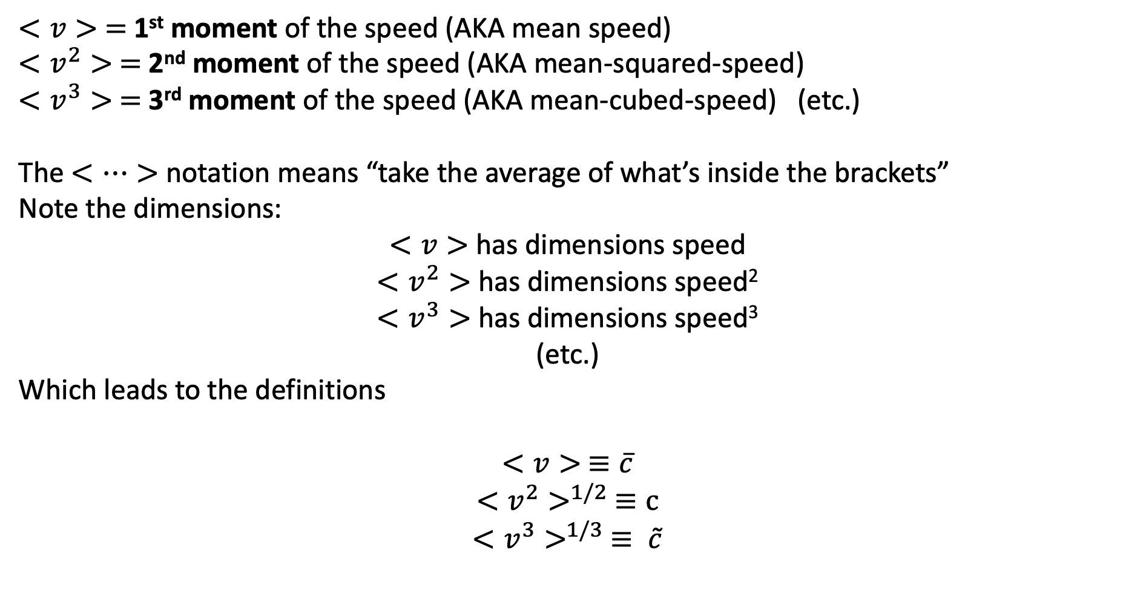
Behind the c’s: Moments
$<v> =$1st moment of the speed (AKA mean speed)
$<v^{2}> =$2nd moment of the speed (AKA mean-squared-speed)
$<v^{3}> =$3rd moment of the speed (AKA mean-cubed-speed) (etc.)
The $<…>$notation means “take the average of what’s inside the brackets”
Note the dimensions:
$<v>$ has dimensions speed
$<v^{2}>$ has dimensions speed²
$<v^{3}>$ has dimensions speed³
(etc.)
Which leads to the definitions
$$<v> ≡\overline{c}$$
$$<v^{2}>^{1/2} ≡c$$
$$<v^{3}>^{1/3} ≡ \tilde{c}$$

Slide 3





The Ergodic hypothesis
Thermodynamics offers three equivalent ways to think about averages:
Follow one molecule over time
Take a snapshot of a bunch of molecules at a given instant
Asserting the equivalence of #1 and #2 is called the ergodic hypothesis.
Weight each speed by its probability and add them.
Asserting #3 is just math.
$<v>_{time}$
$<v>_{particles}$
$$f_{M}$$
$<v>_{probability}$
$$v$$

Slide 4
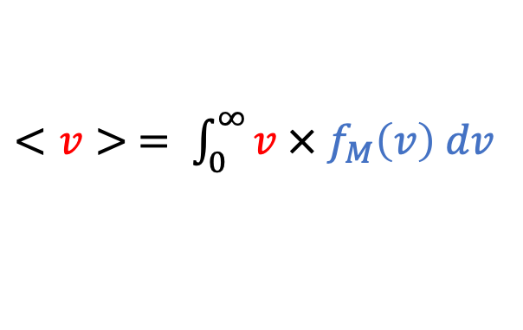
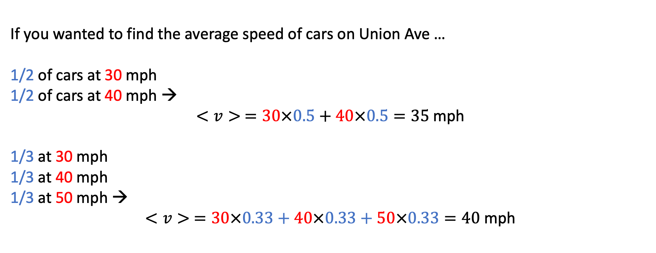
Method #3: Probability-weighted averaging
$<v> = \int_{0}^{∞}{v × f_{M}\left(v\right) dv}$
speed
probability
If you wanted to find the average speed of cars on Union Ave …
1/2 of cars at 30 mph
1/2 of cars at 40 mph →
$<v> =30×0.5+40×0.5=35$mph
1/3 at 30 mph
1/3 at 40 mph
1/3 at 50 mph →
$<v> =30×0.33+40×0.33+50×0.33=40$ mph

Slide 5
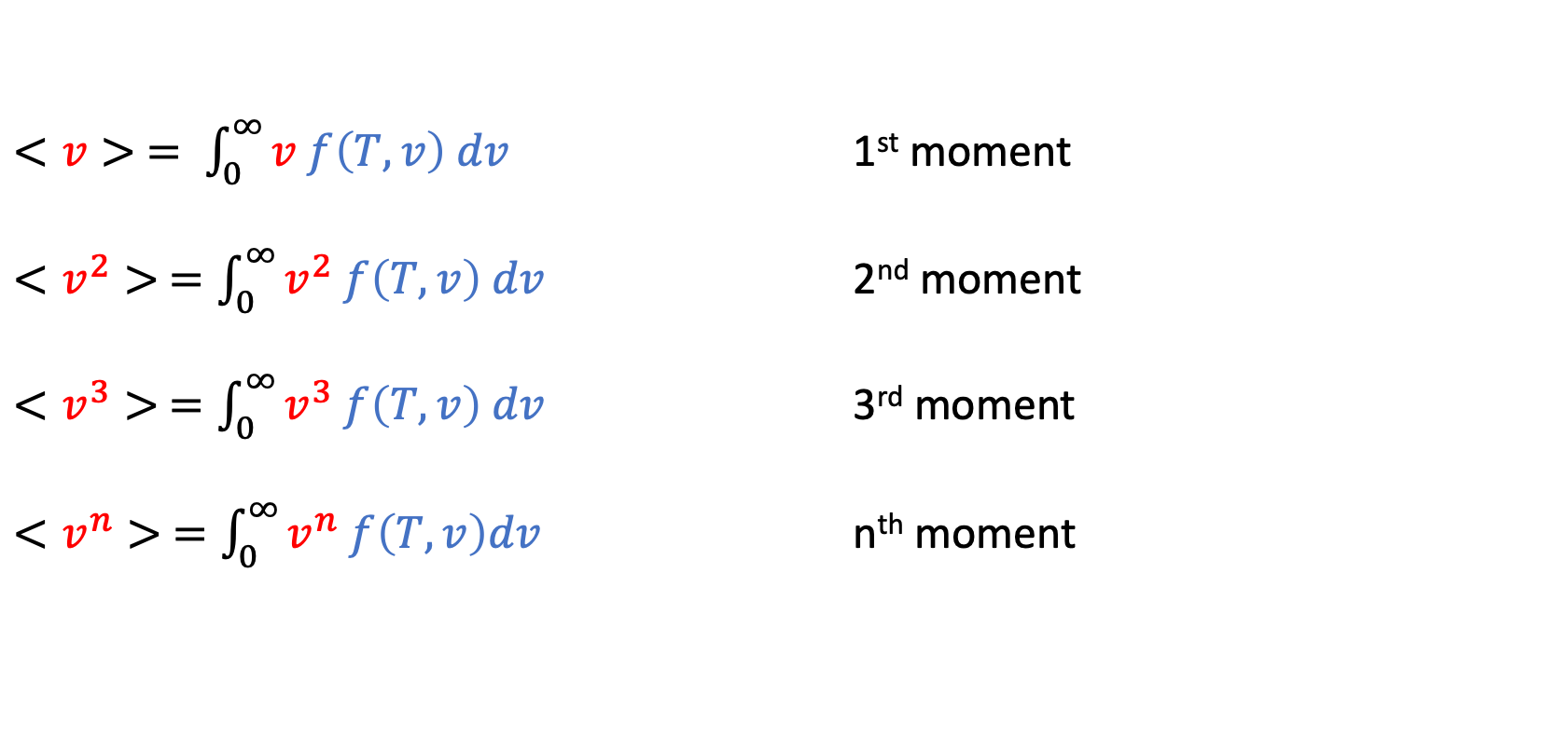
Generalizations
$<v> = \int_{0}^{∞}{v f\left(T,v\right) dv}$ 1st moment
$<v^{2}> =\int_{0}^{∞}{v^{2} f\left(T,v\right) dv}$ 2nd moment
$<v^{3}> =\int_{0}^{∞}{v^{3} f\left(T,v\right) dv}$ 3rd moment
$<v^{n}> =\int_{0}^{∞}{v^{n} f\left(T,v\right)dv}$ n^{th} moment

Slide 6
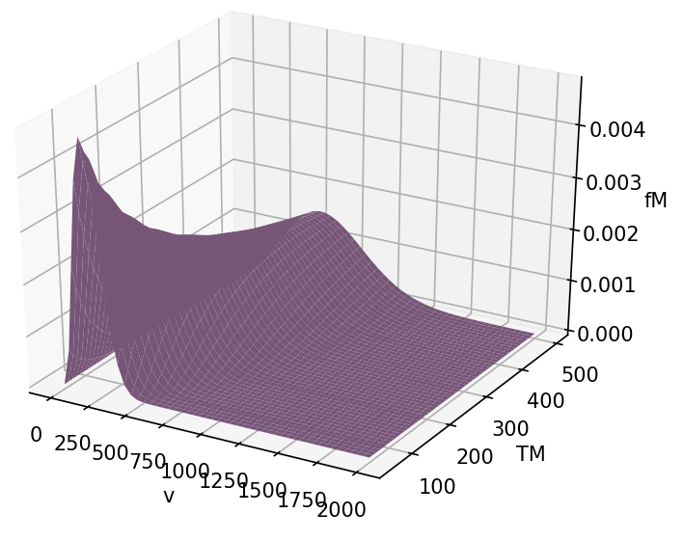
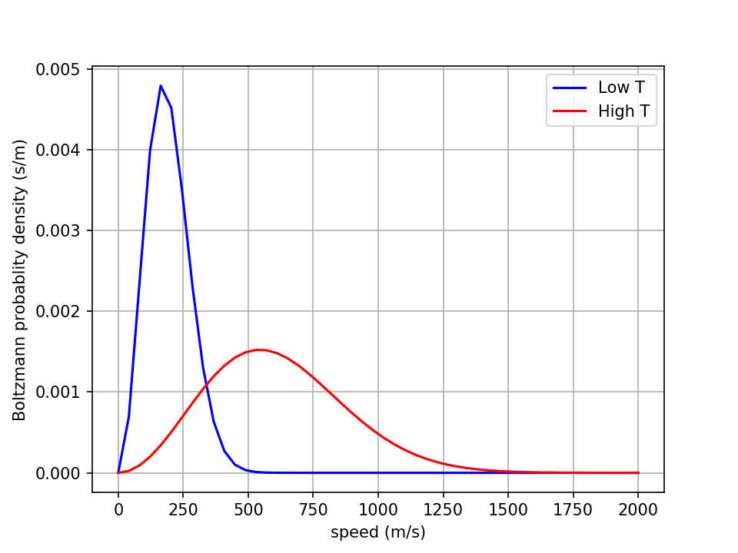
Numerical approach – first we slice

Slide 7
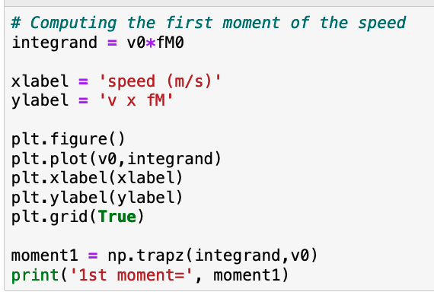
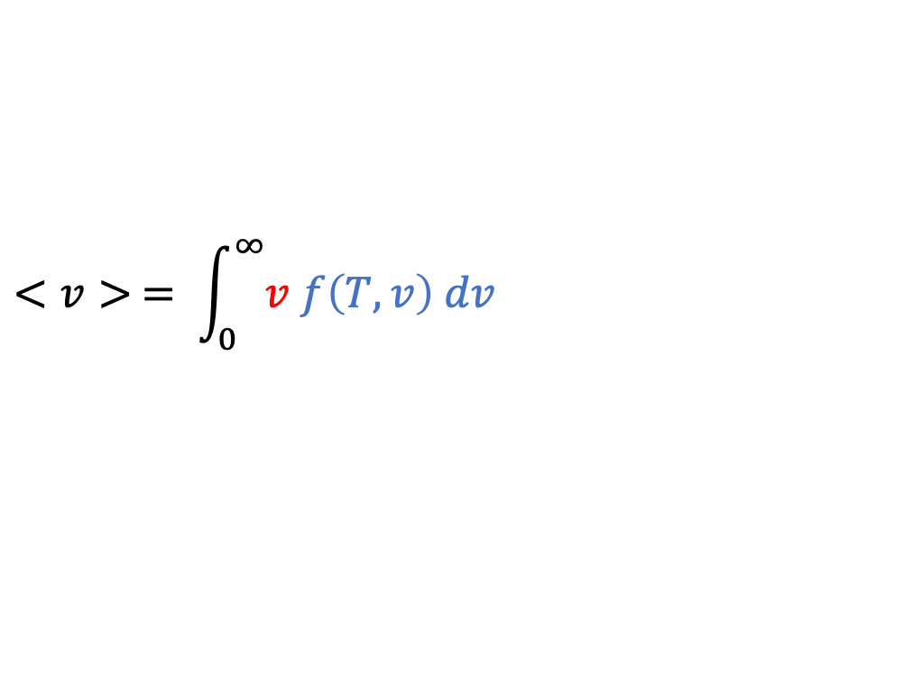
Then we compute the integrand
$$<v> = \int_{0}^{∞}{v f\left(T,v\right) dv}$$
integrand

Slide 8
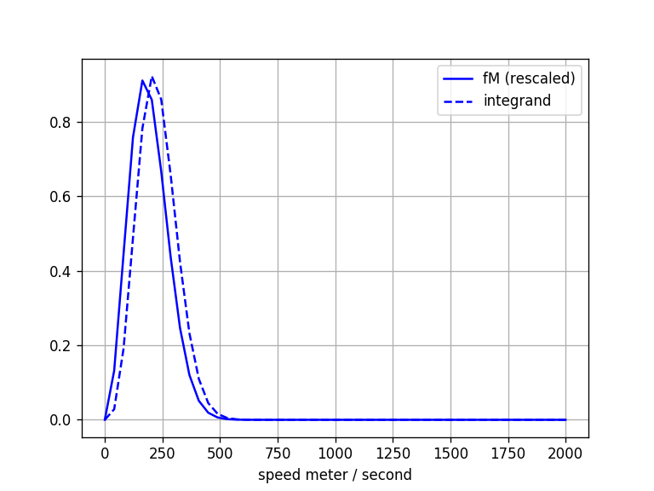
Then we graph the integrand
$$<v> = \int_{0}^{∞}{v f\left(T,v\right) dv}$$
integrand

Slide 9
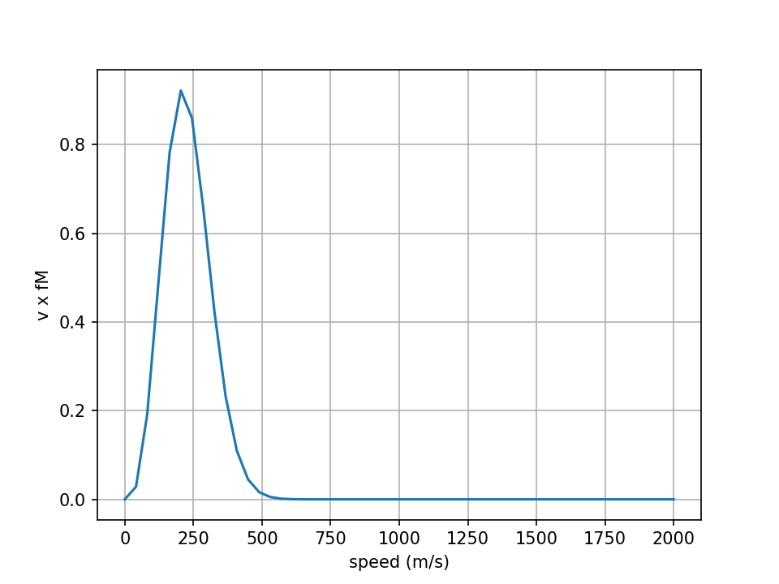
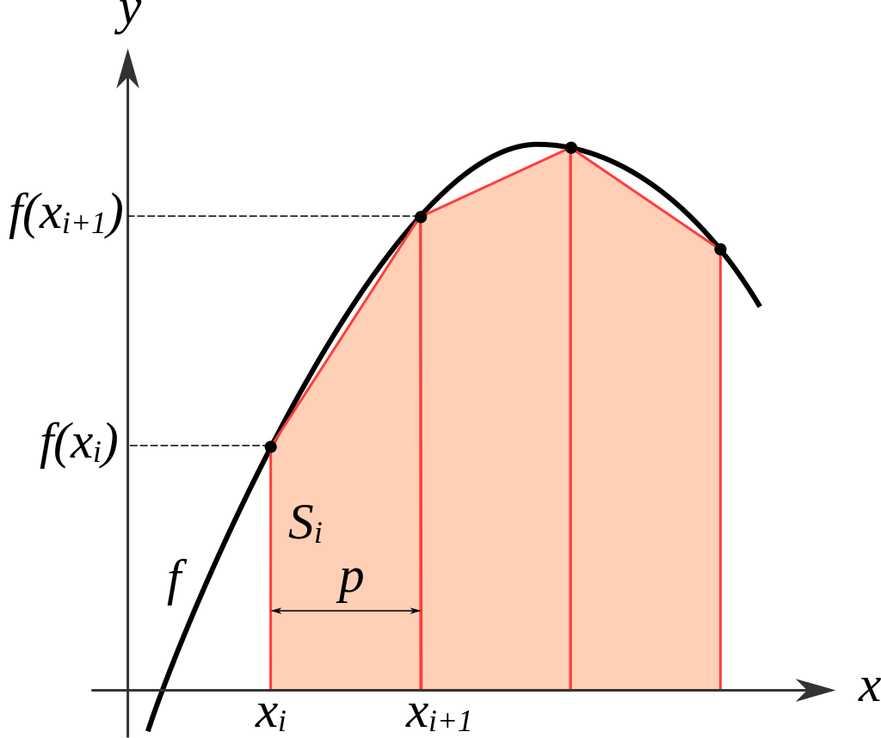
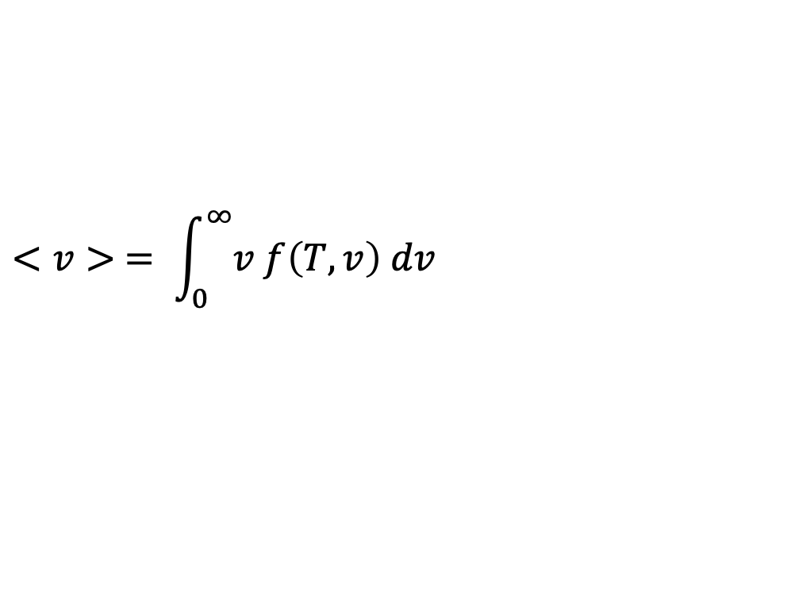
Then we integrate numerically using the trapezoidal rule
https://en.wikipedia.org/wiki/Trapezoidal_rule
$$<v> = \int_{0}^{∞}{v f\left(T,v\right) dv}$$

Slide 10
